Slide 1
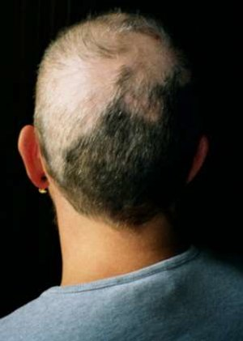
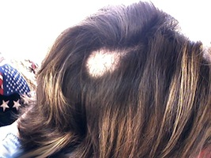
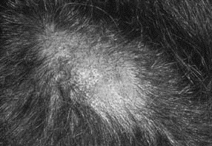
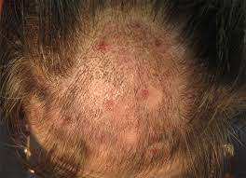
Trichotillomania

Slide 2
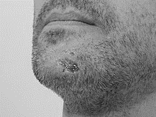
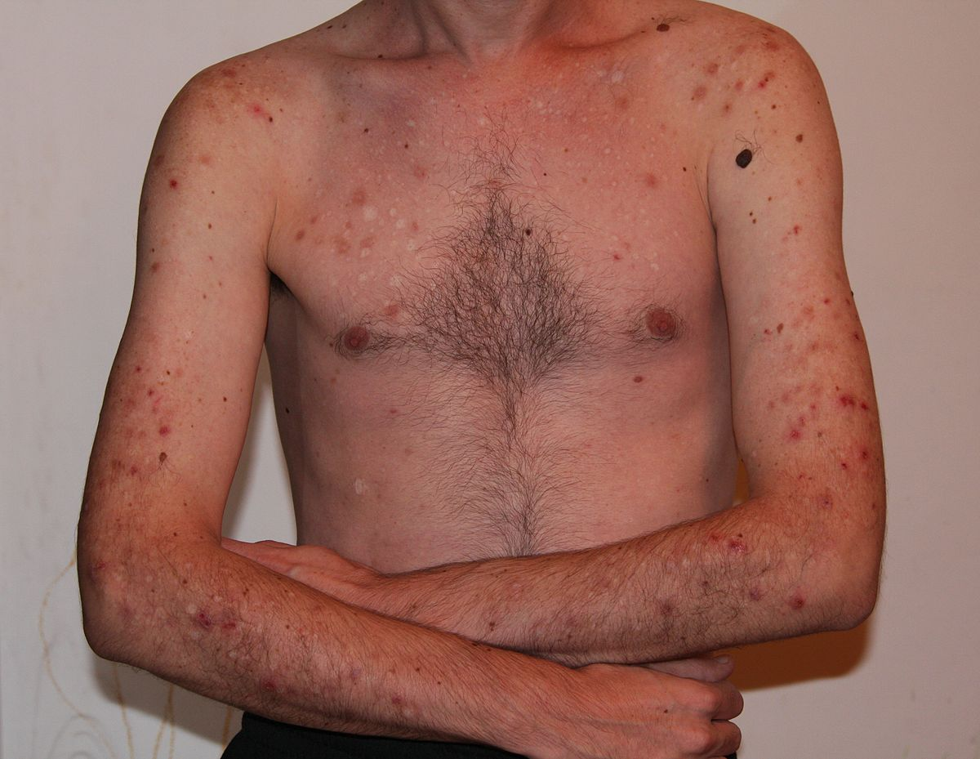
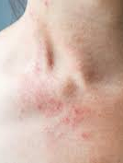
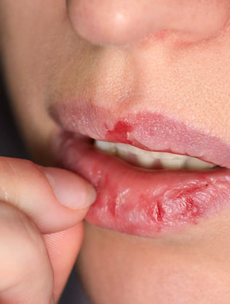
Excoriation

Slide 3
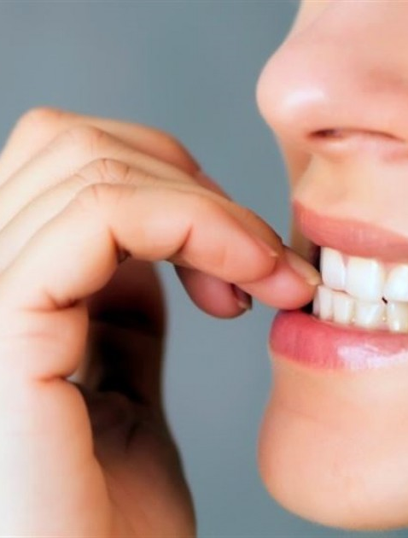
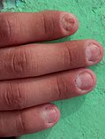
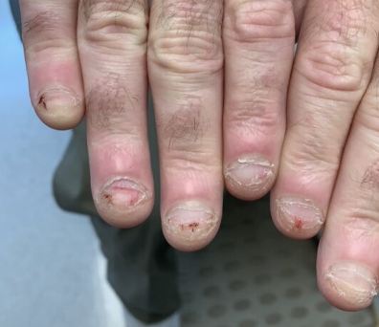
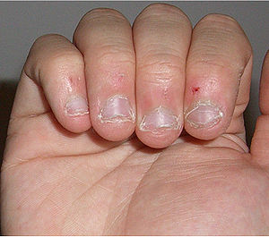
Onychophagia

Slide 4
Body-Focused Repetitive Behavior

Slide 5
Development of Microcontroller Based Wearable Device with Monitoring System for Body-Focused Repetitive Behavior

Slide 6
Rationale
Body-focused repetitive behavior (BFRB) is a term that refers to a group of compulsive habits that unintentionally harm one's body and alter one's appearance (Abrahams & Trotzky, 2017). In a related study published in npj Digital Medicine, a team lead by Child Mind Institute researchers found that utilizing heat sensors in addition to inertial measurement and proximity sensors, a wearable tracking system they designed achieves greater accuracy in position tracking.
This project will assist in the treatment of the Body-Focused Repetitive Behavior (BFRB patient). The device will be able to send a signal to the patient by using the vibration motor; it has a trained model implemented to the microcontroller by using its accelerometer and gyroscope in addition of distance sensor to improve the accuracy.

Slide 7
Objectives of the Study
To develop a microcontroller based wearable technology that conveys a signal to the patient.
To embed mobile application for motion sensors in real time.
To assist in the treatment of the Body-Focused Repetitive Behavior (BFRB patient) with the proposed project.

Slide 8
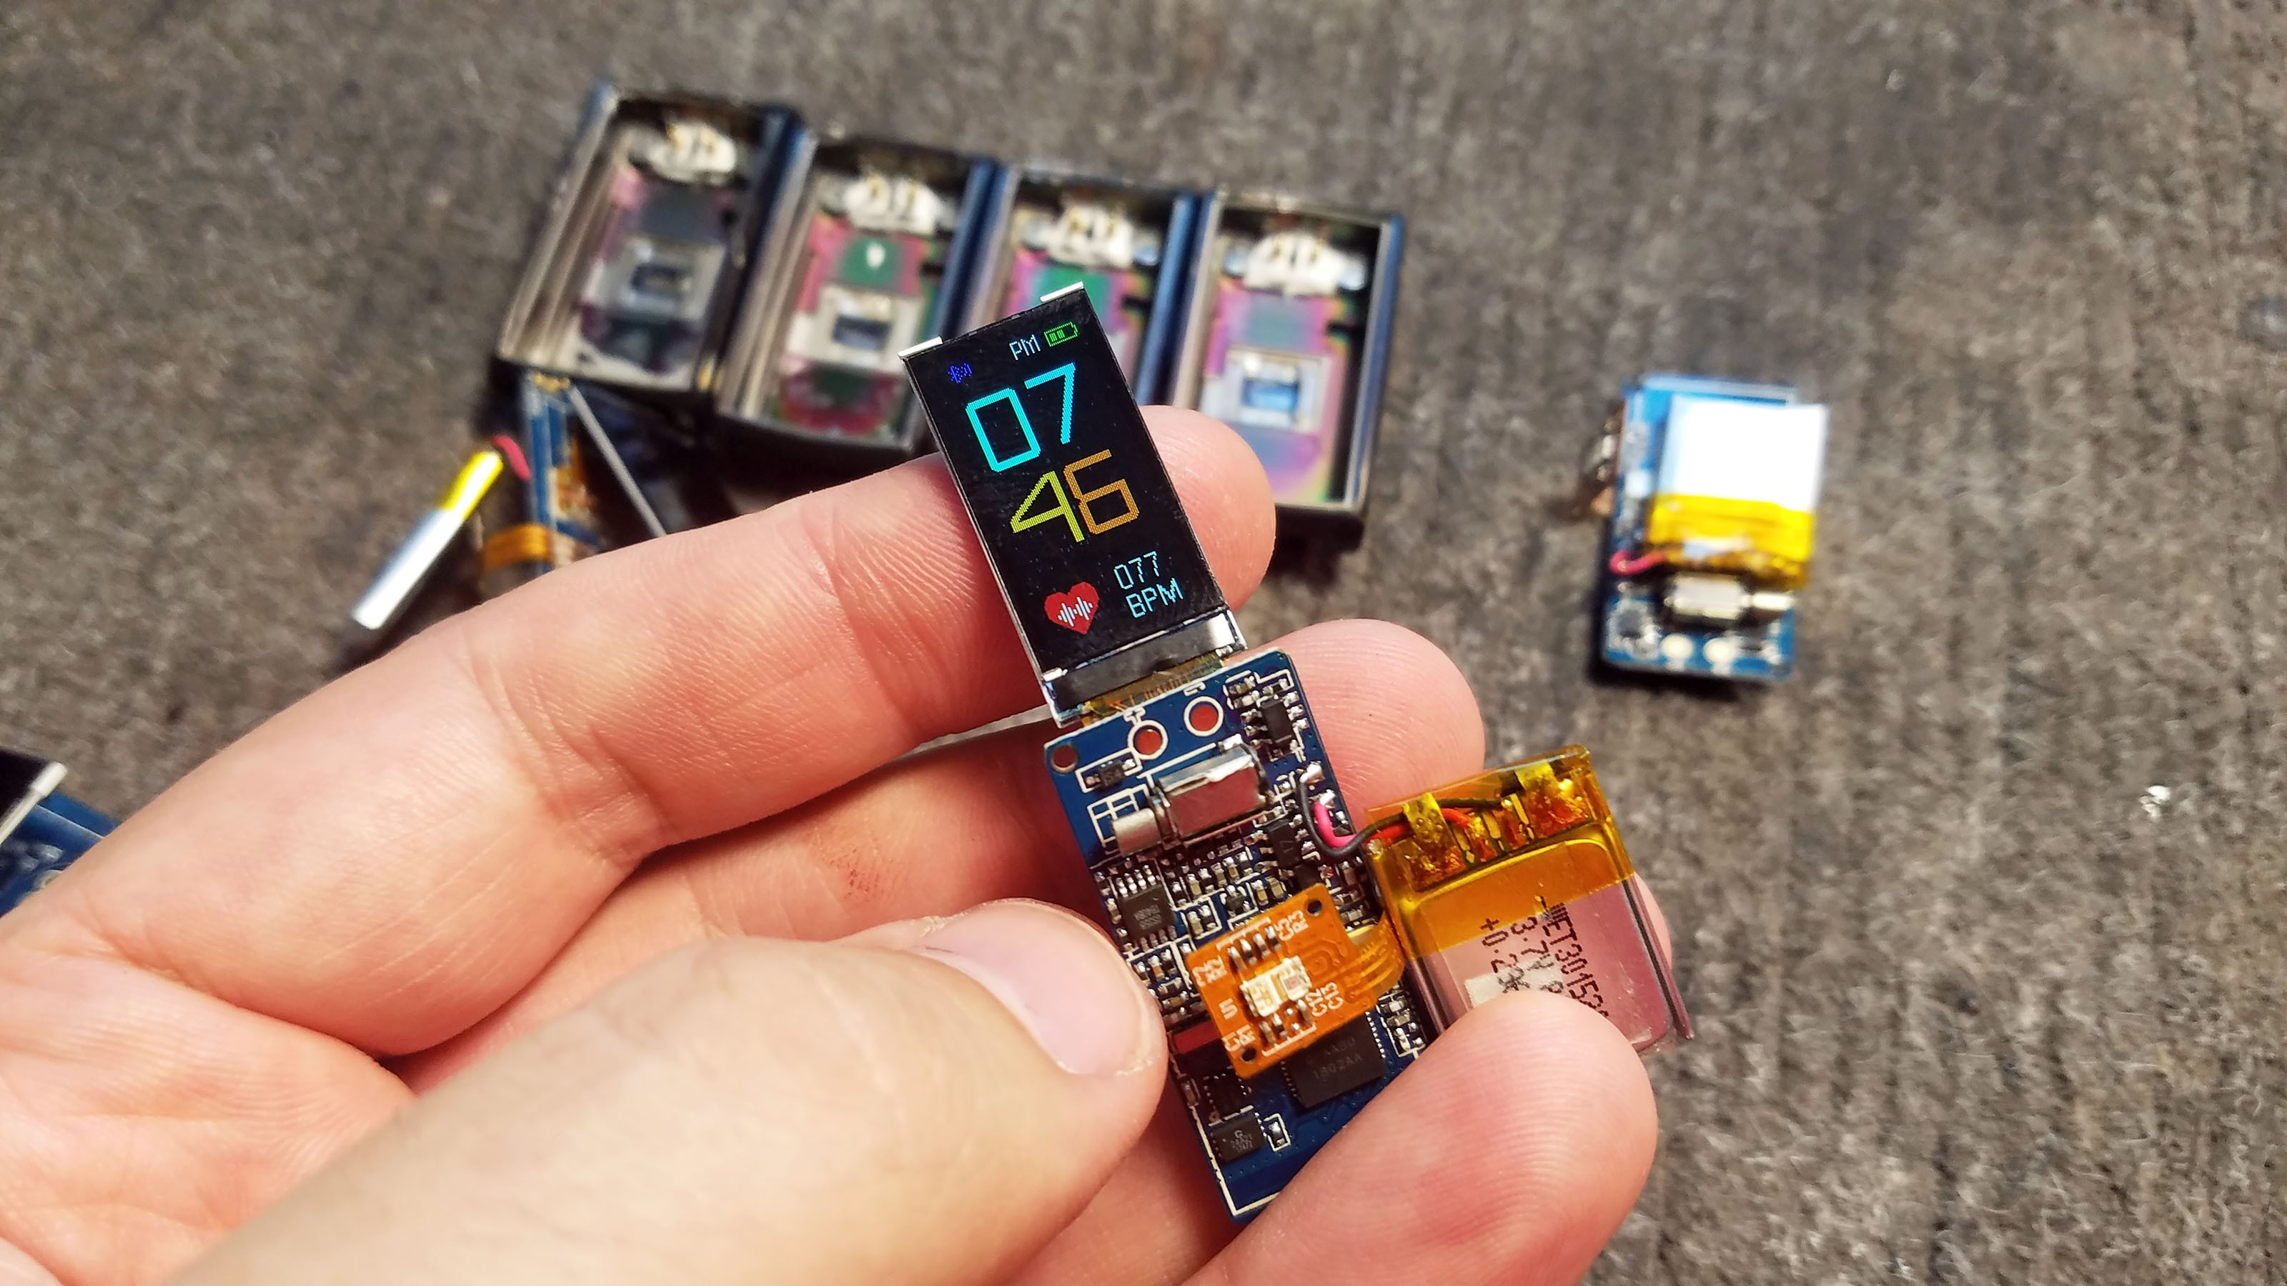
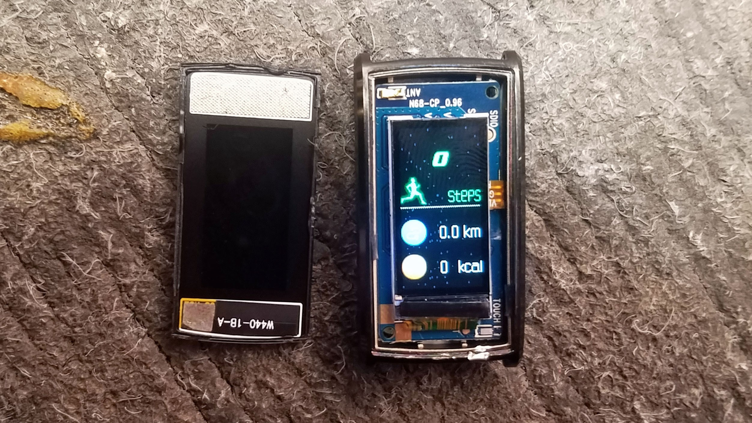
Our inspiration
The “Tingle” by npj Digital Medicine, Child Mind Institute - They disassembled and used N68 Fitness Tracker (ref) as their main component for their PCB along with the MCU and IMU. However besides of the appearance, the price is on the expensive side and is not affordable for the public use.
https://hackaday.io/project/144350-hacking-wearables-for-mental-health-and-more

Slide 9
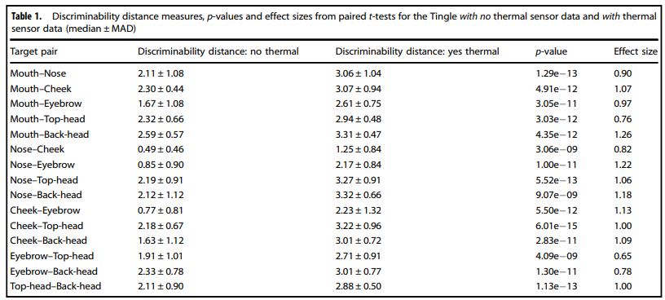
Our inspiration
doi.org/10.1038/s41746-019-0092-2

Slide 10
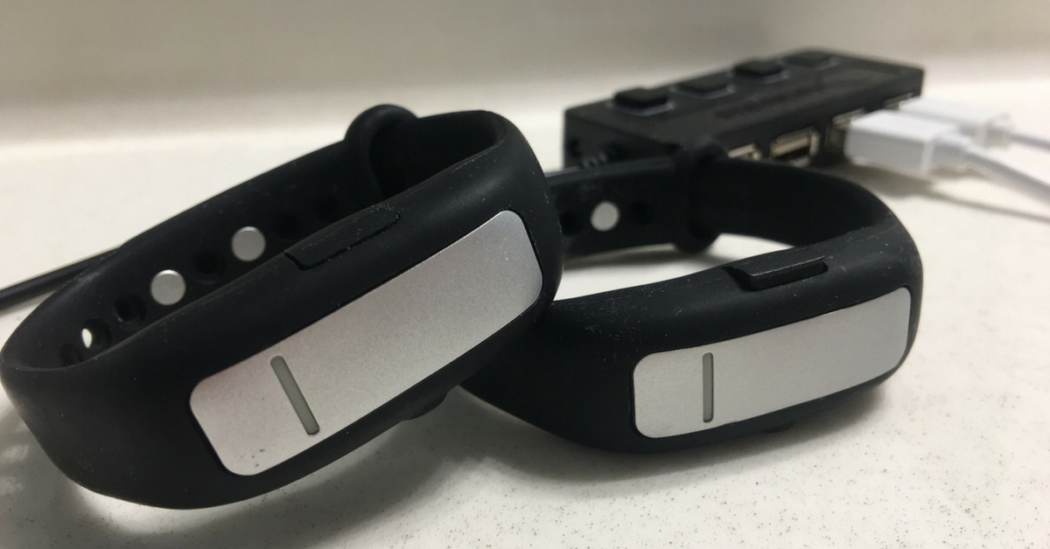
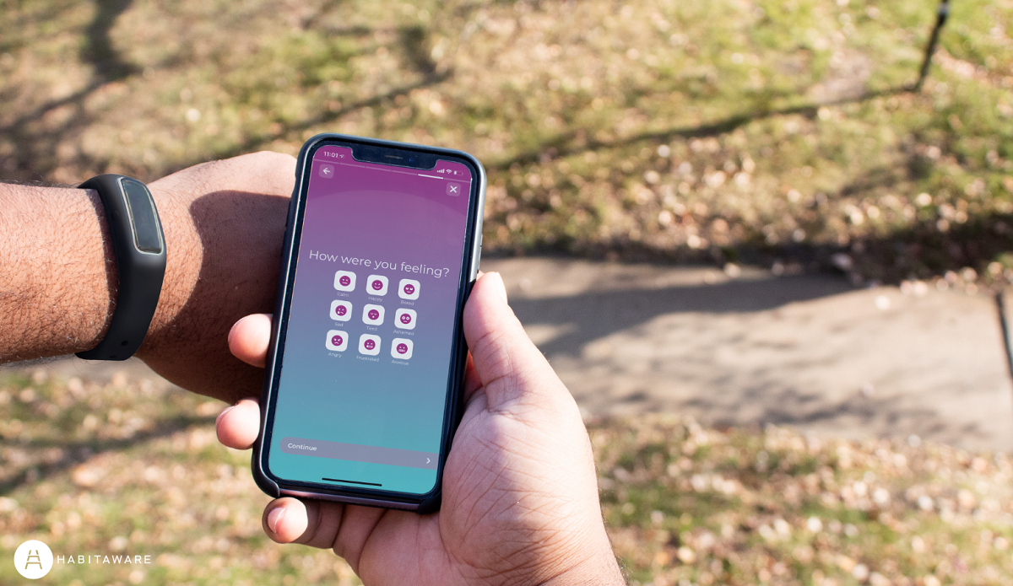
Our inspiration
The “Keen” created by HabitAware – uses a gesture recognition for the initial use that makes the device recognize such habit. It then transmits a vibration signal to the patient wearing the device. Despite that, no published peer-reviewed study has shown the effectiveness of this device. There are testimonies that are presented in their website, but these are not great evidence to say that the device is well-suited for BFRB monitoring or treatment.
https://habitaware.com/

Slide 11
Methodology MATERIALS
Arduino Nano 33 BLE Sense - Microcontroller
VL53L0X ToF Sensor – Proximity
Pulse Sensor – Tracker
Micro Vibration Motor – Haptic Feedback
Hand crafted Chassis – device’s chassis

Slide 12
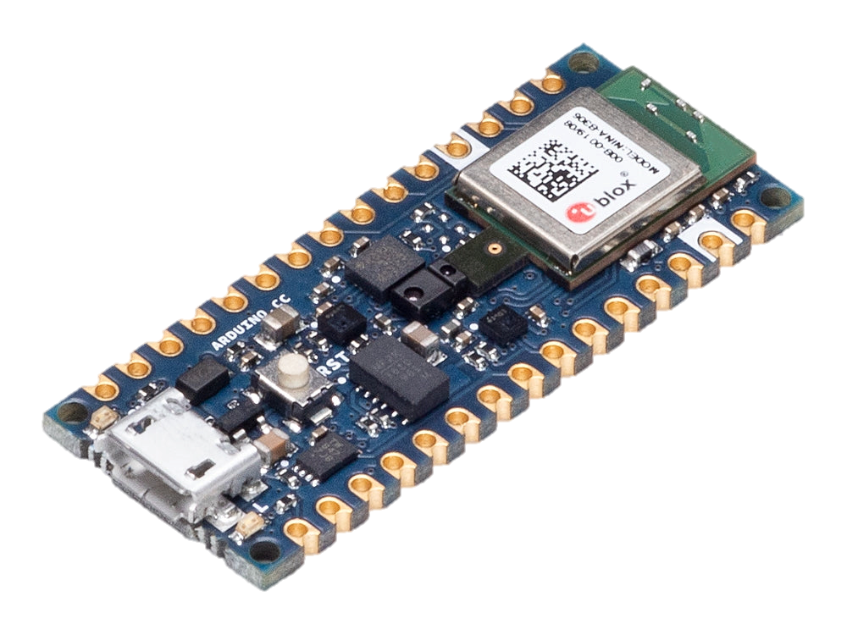
Arduino Nano 33 BLE Sense

Slide 13
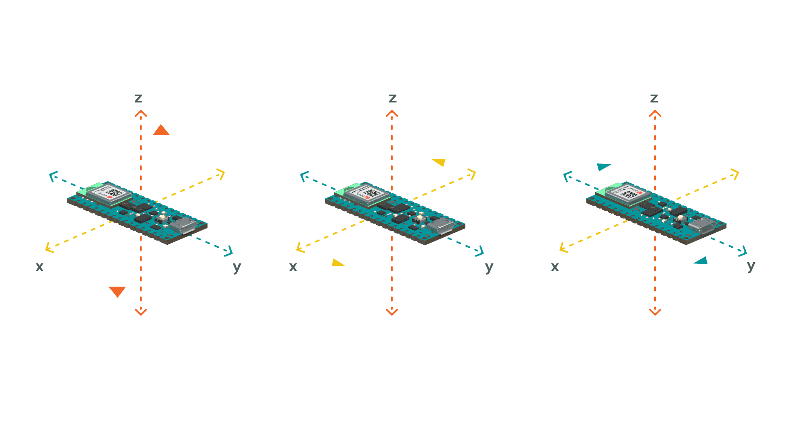
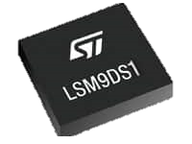
Accelerometer

Slide 14
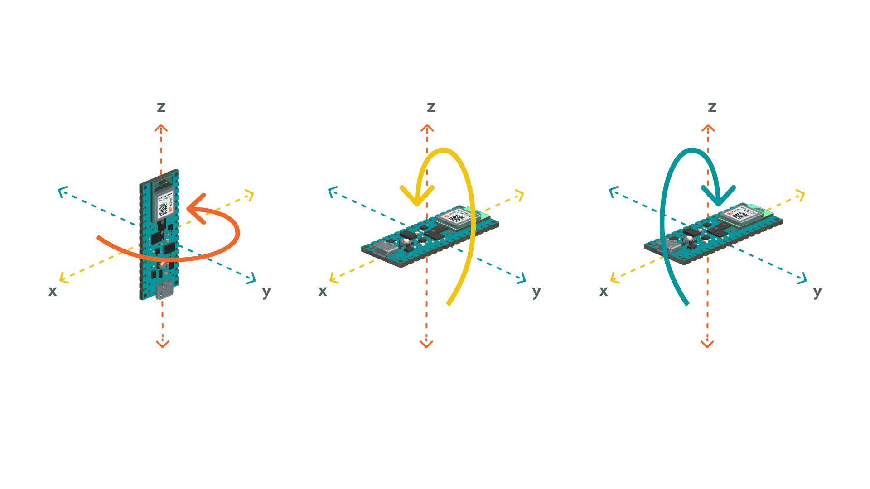
Gyroscope

Slide 15
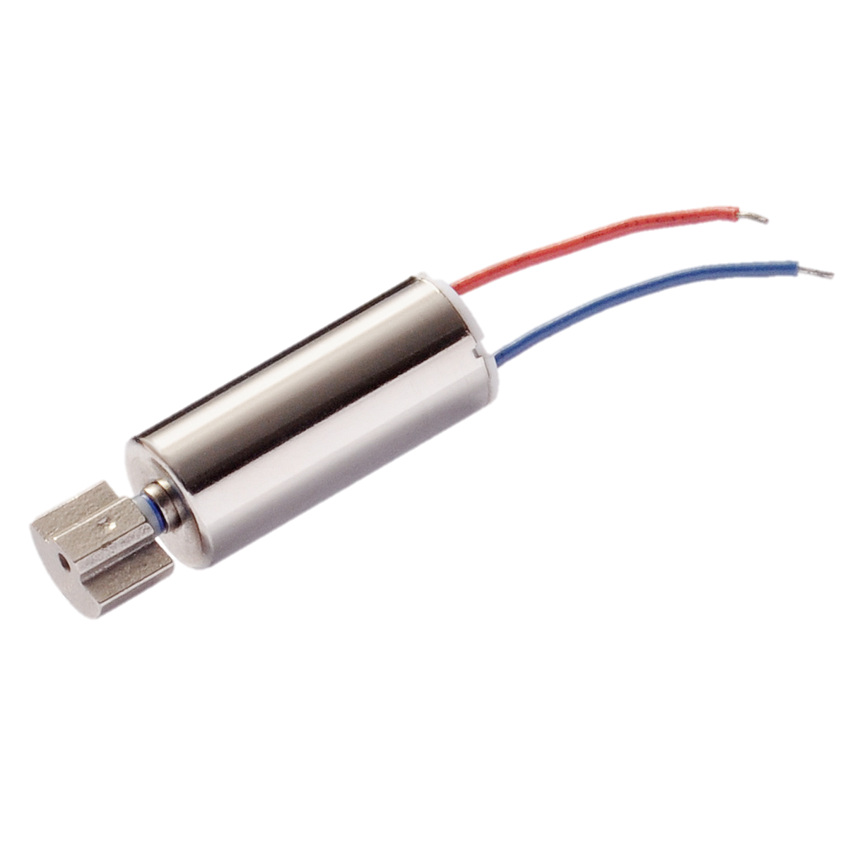
Micro Vibration Motor

Slide 16
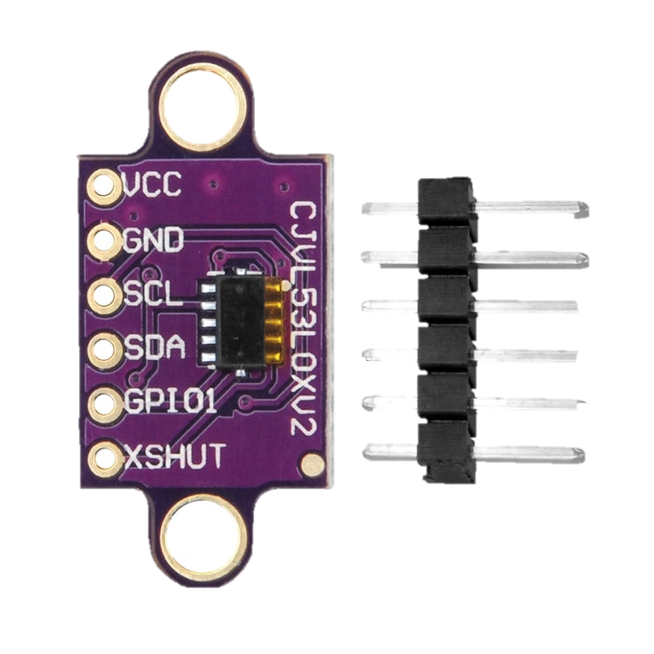
Distance sensor

Slide 17
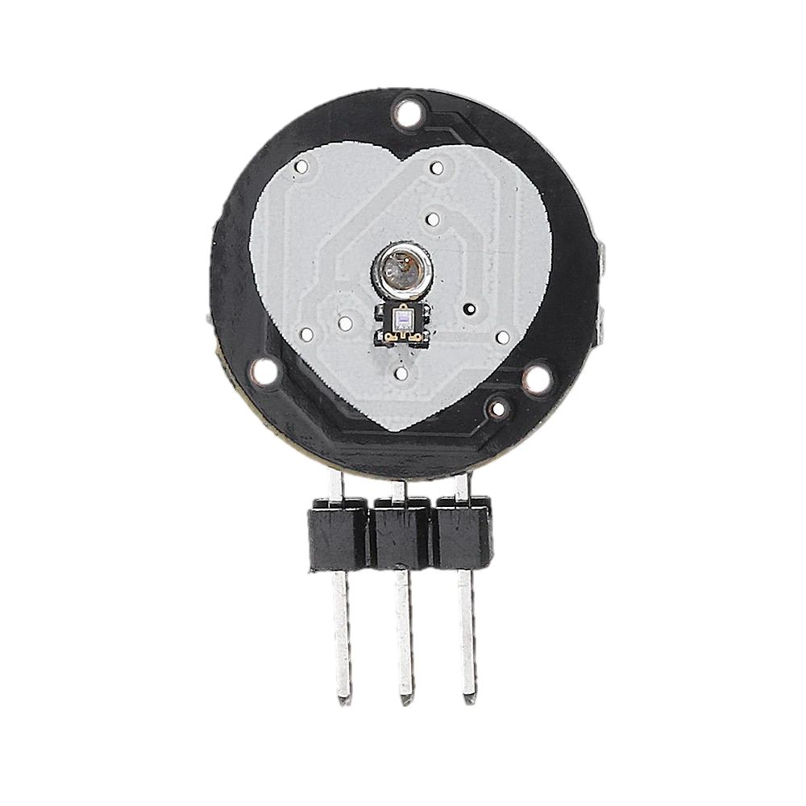
Pulse sensor

Slide 18
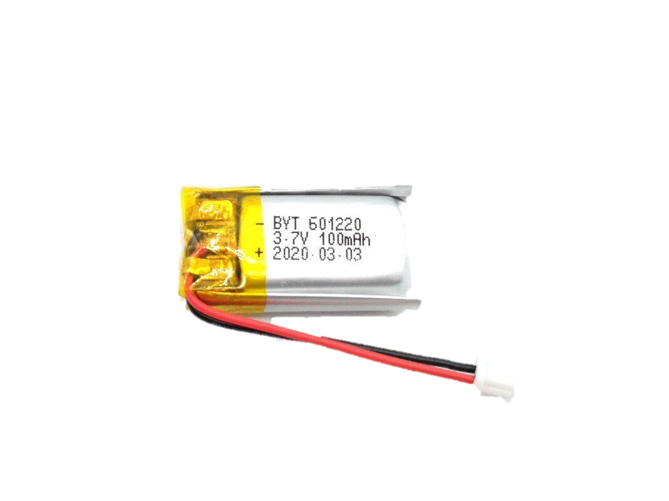
3.7V 110mAh Lithium Polymer Battery

Slide 19
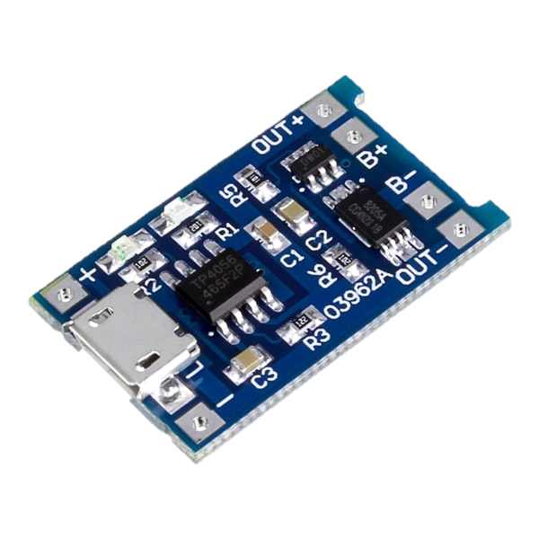
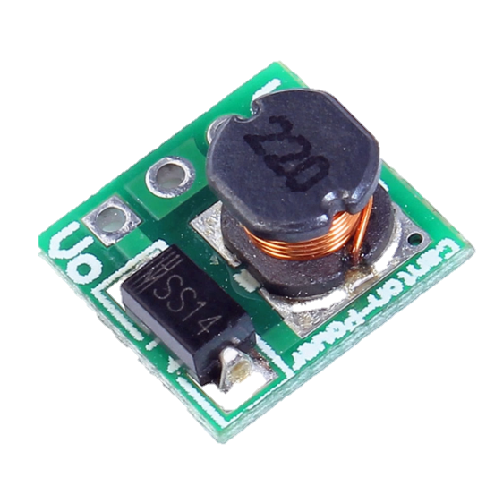
Charger Module
Step-up converter

Slide 20
Methodology SOFTWARE
Python
TensorFlow Lite – platform for machine learning
Django – web framework (handles backend)
JavaScript
Web BLE – connection for specific UUID (Universally Unique Identifier)
CRC32 powered file transfer – cyclic redundancy check over the trained model file
Plotting module – handles the real time graph
C++
Arduino – MCU board

Slide 21
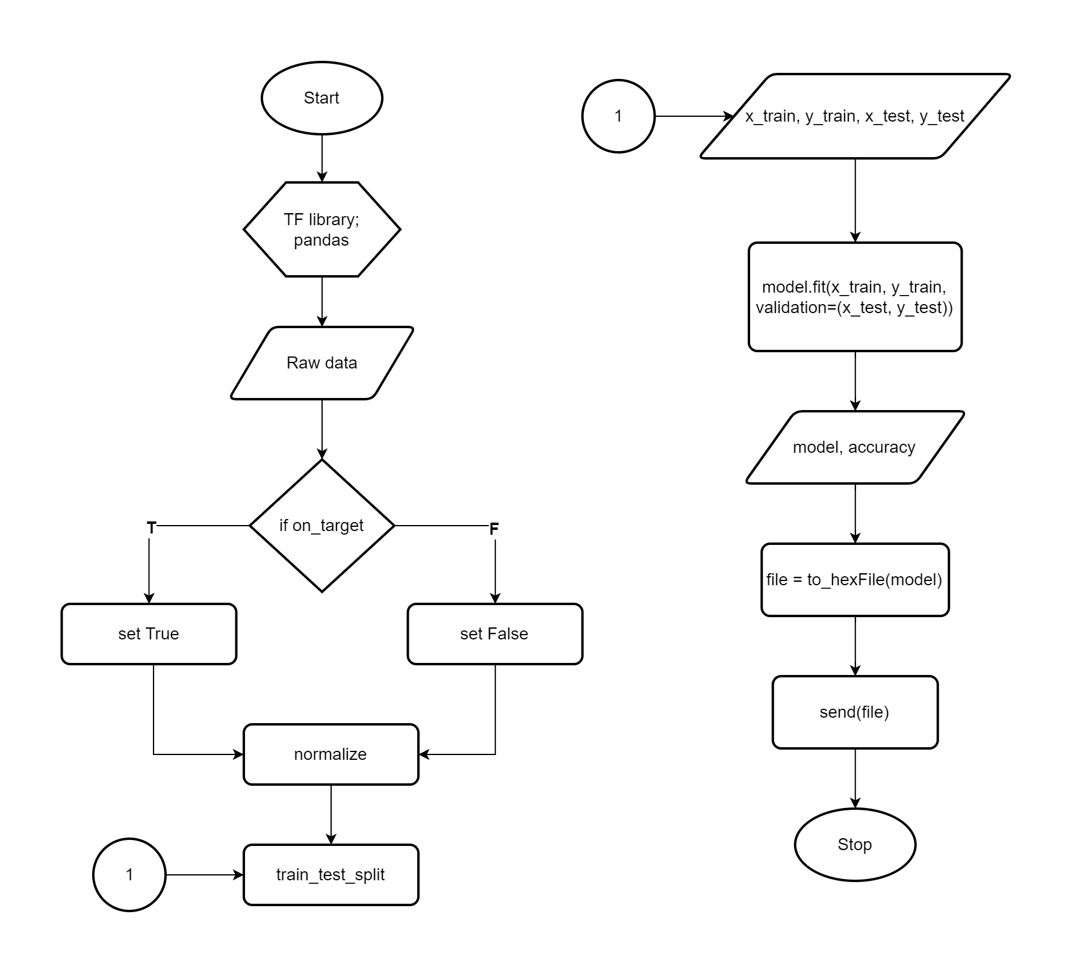

Slide 22
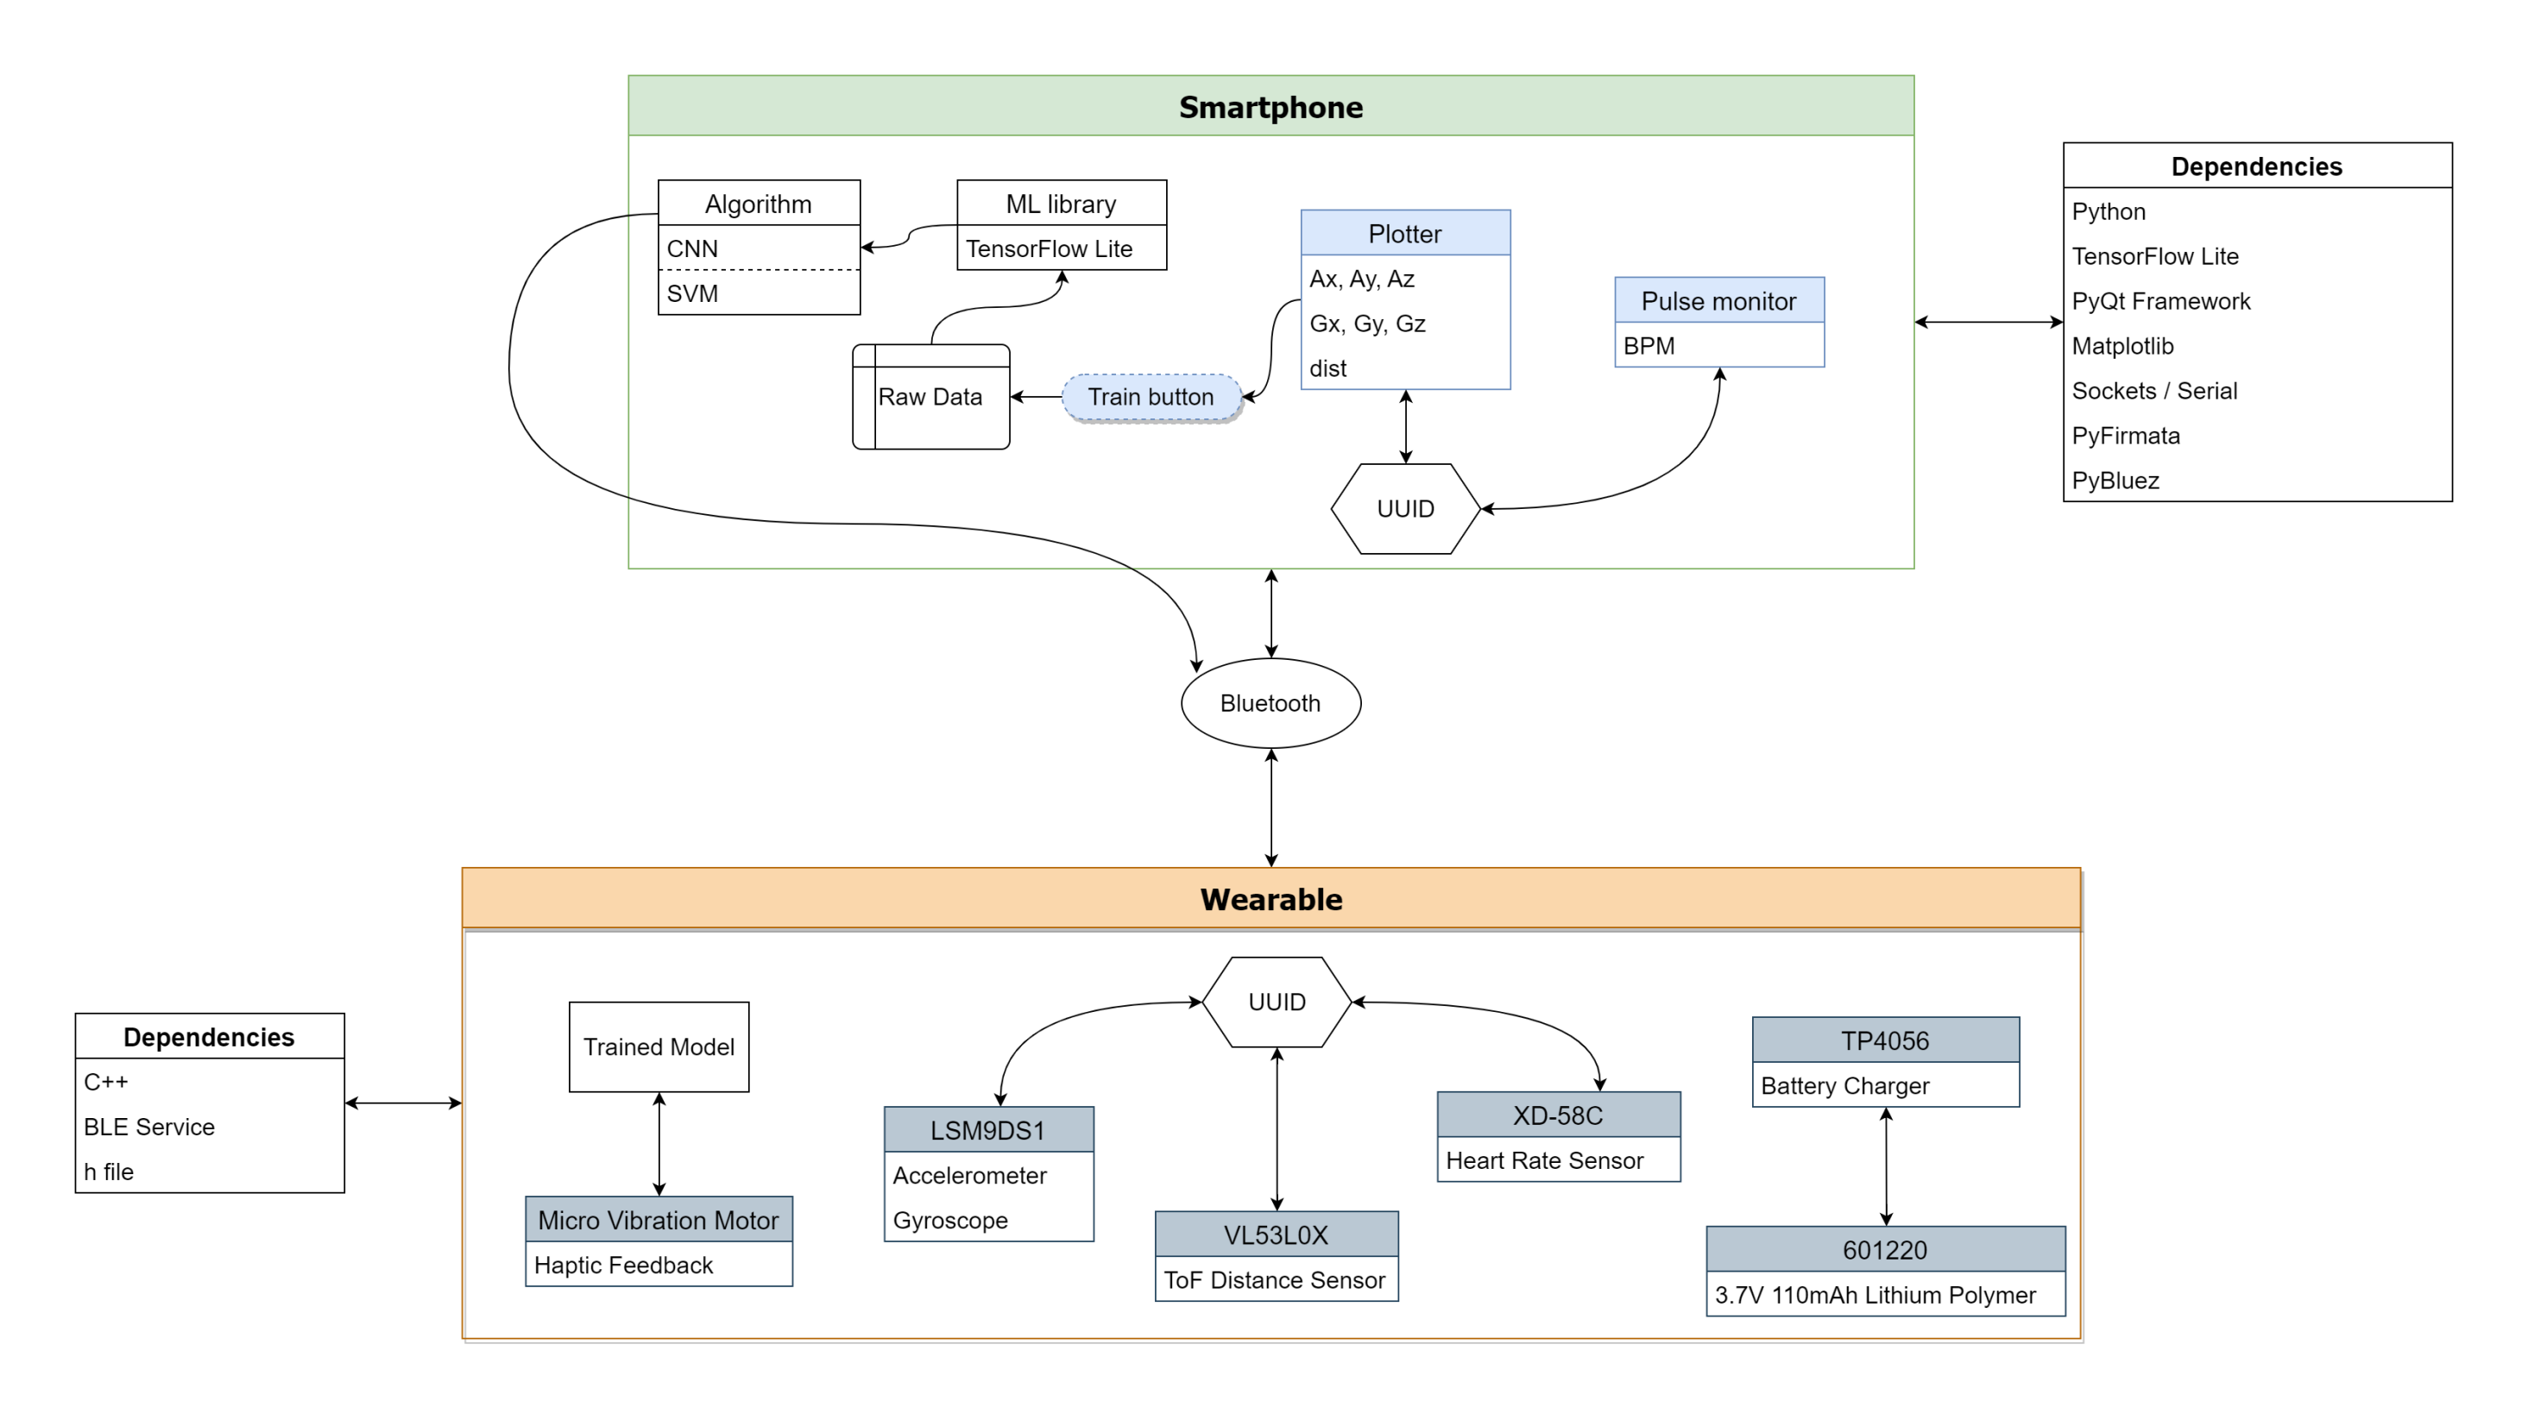

Slide 23
Methodology TESTING
Unit & Integration test – each features completion
System test – complete product validation
User acceptance – patient evaluation with BFRB disorder

Slide 24
Budgetary Estimate
Purpose | Component | Quantity | Unit Cost (Php)
Microcontroller | Arduino Nano 33 BLE Sense | 1 | 3,762
Proximity | VL53L0X ToF Sensor | 1 | 117
Tracker | Pulse Sensor | 1 | 136
Haptic Feedback | Micro Vibration Motor | 1 | 35
Power | 601220 Lithium Polymer Battery | 1 | 108
 | TP4056 Charger Module | 1 | 25
Connections | SPDT Slide Switch | 1 | 12
 | Stranded Wire | 2 | 10
 | Jumper Wire | 20 | 60
Chassis | Handcrafted wristwatch case | 1 | 200
Total |  |  | 4,465
Overall estimated cost = Php 5,100

Slide 25
Expected Output

Slide 26
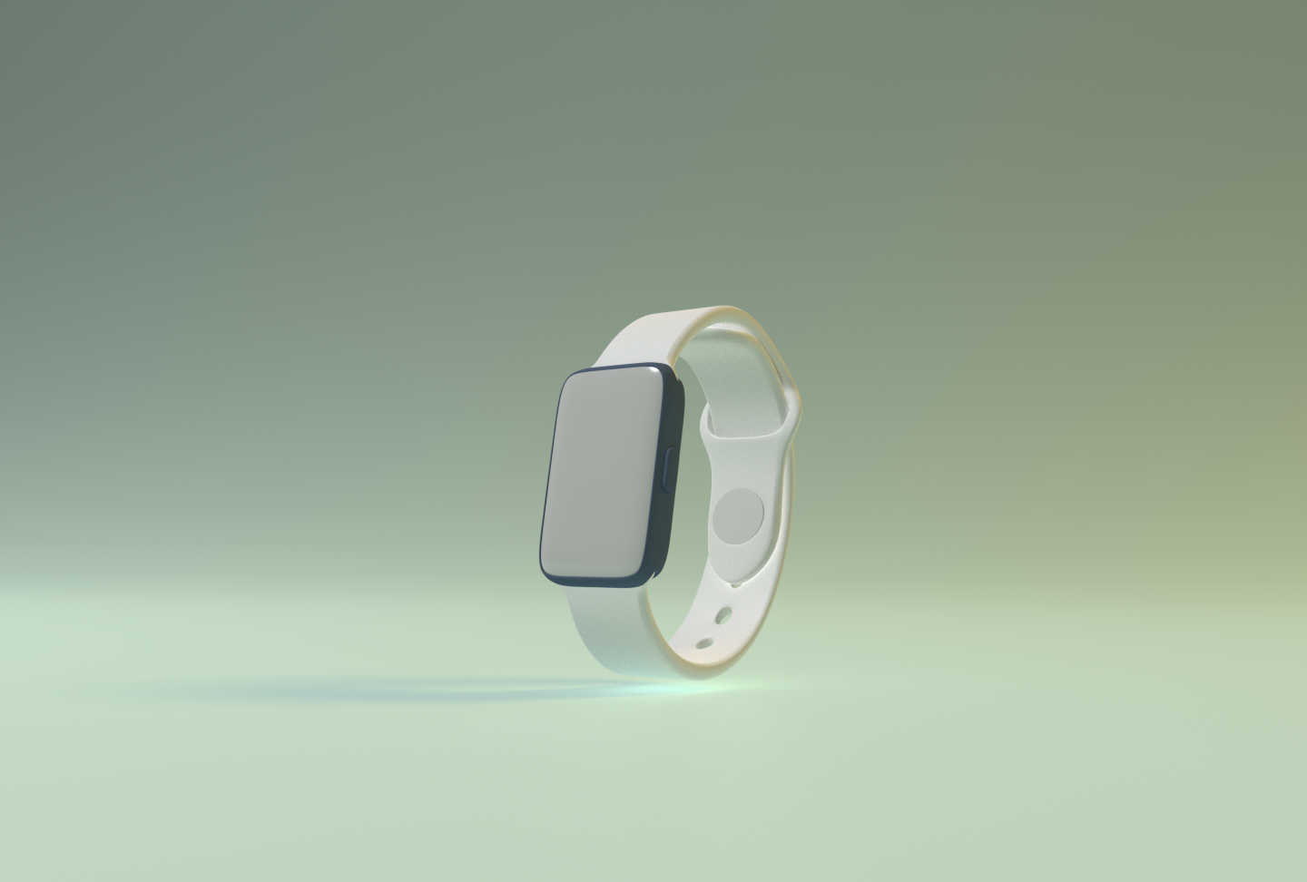
~ Framing only

Slide 27
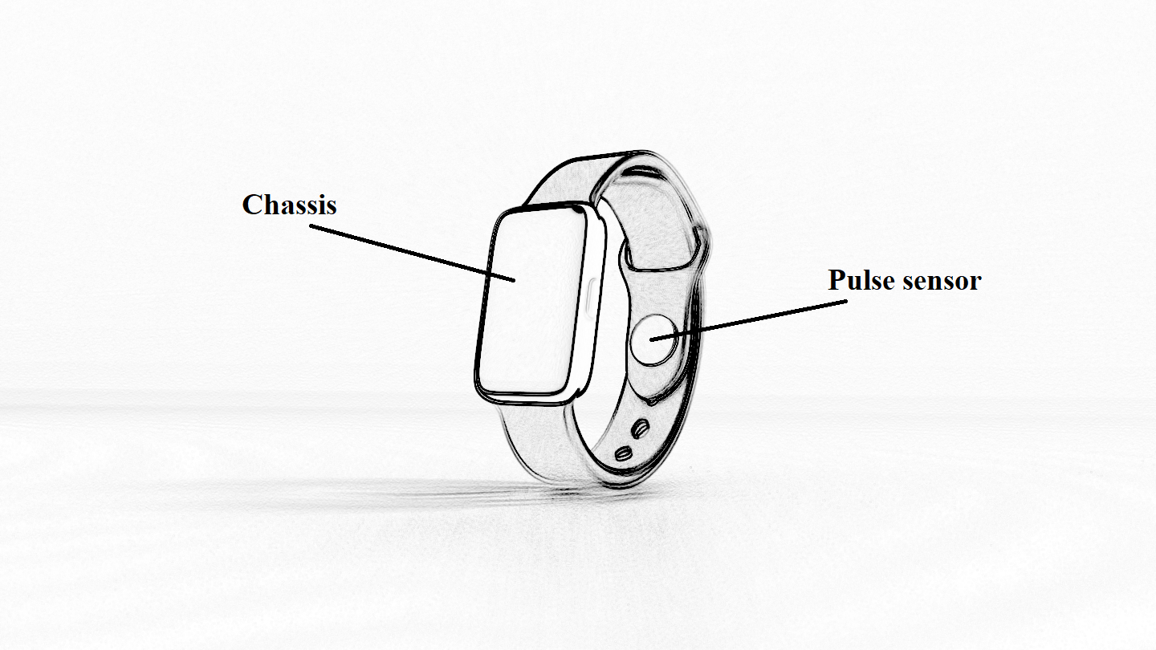

Slide 28
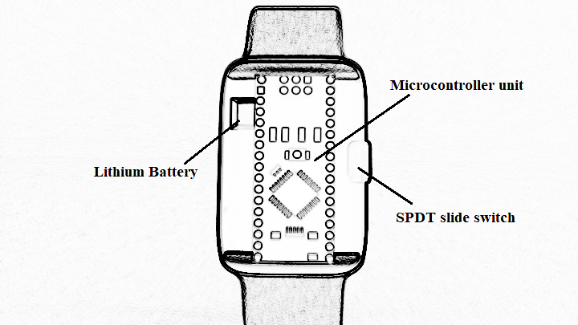

Slide 29
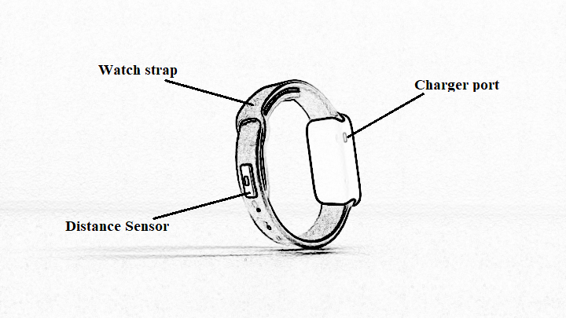

Slide 30
In the future, we should get …
CRC32 – block size effectiveness
Neural Network – accuracy rate
BFRB – test on three said types
Sensors – dependencies to have an accurate prediction

Slide 31
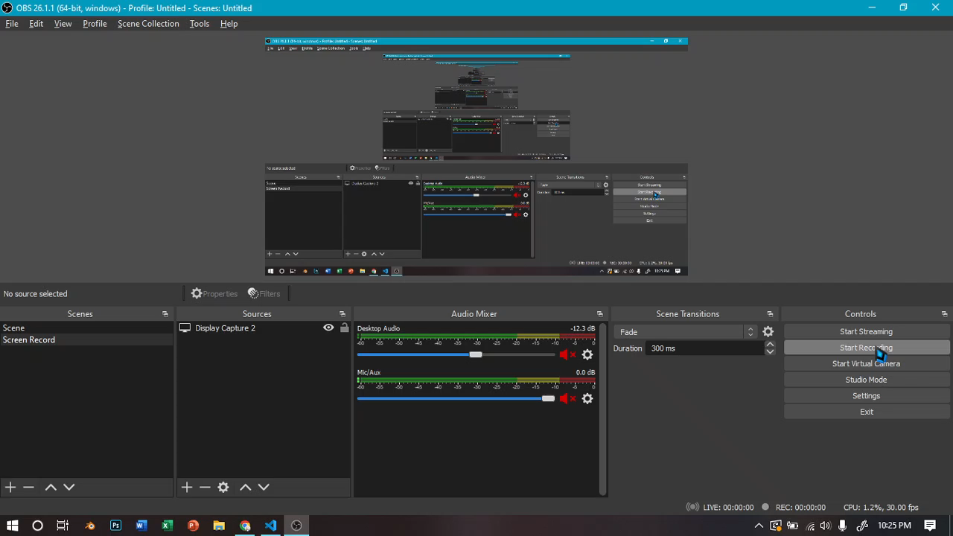

Slide 32
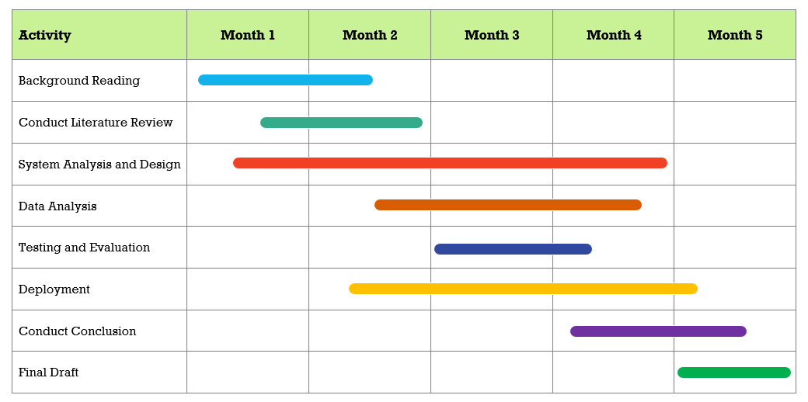
Gantt Chart of Activities

Slide 33
Thank you!
Ryan Christopher D. Bahillo & Iriks Maria B. Dalanon
BS in Computer Engineering, 4-1

